Slide 1
A Dog’s Life
Proposal for Website

Slide 2
SiteMap
Home page
Contact Information
Map to Store
Grooming Services
How to select a good pet

Slide 3

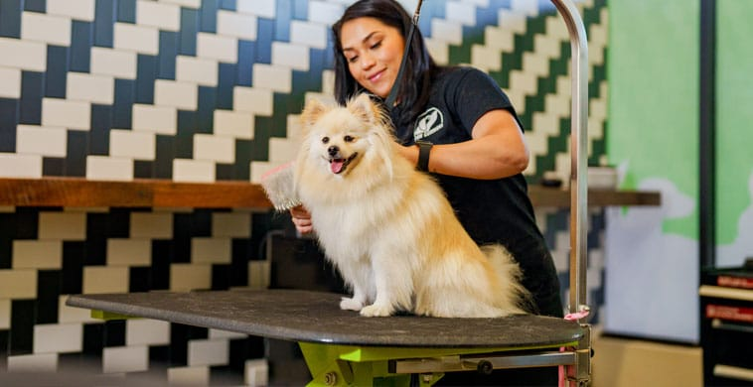
Home
A Dog’s Life
Home
Services
How to
Contact
A Dog’s Life
Home Services How To Contact
Custom Dog Grooming Services in Scottsdale, AZ
Custom Dog Grooming Services in Scottsdale, AZ

Slide 4
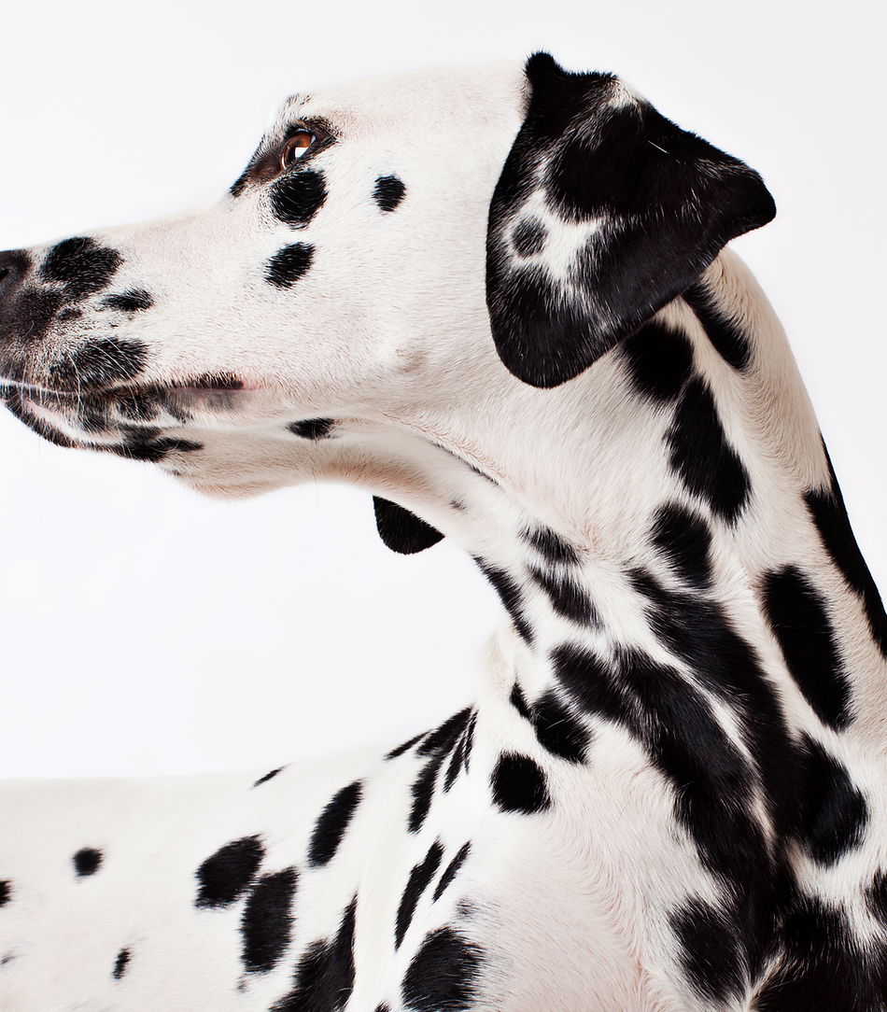

Services
A Dog’s Life
Home
Services
How to
Contact
A Dog’s Life
Our Services
Our Services
Grooming
Grooming
Daycare
Daycare

Slide 5
How To
7 Factors to Consider When Choosing a Pet
Allergies. Some people are allergic to the dander or saliva that comes with dogs and cats. ...
Your space. Some pets need more space than others, and some landlords or management companies don't allow pets. ...
Your life. ...
Age. ...
Personality and temperament. ...
Life span. ...
Financial situation.
7 Factors to Consider When Choosing a Pet
Allergies. Some people are allergic to the dander or saliva that comes with dogs and cats. ...
Your space. Some pets need more space than others, and some landlords or management companies don't allow pets. ...
Your life. ...
Age. ...
Personality and temperament. ...
Life span. ...
Financial situation.
A Dog’s Life
Home
Services
How to
Contact
A Dog’s Life
How to Select a Good Pet
Home
Services
How to
Contact
How to Select a Good Pet

Slide 6
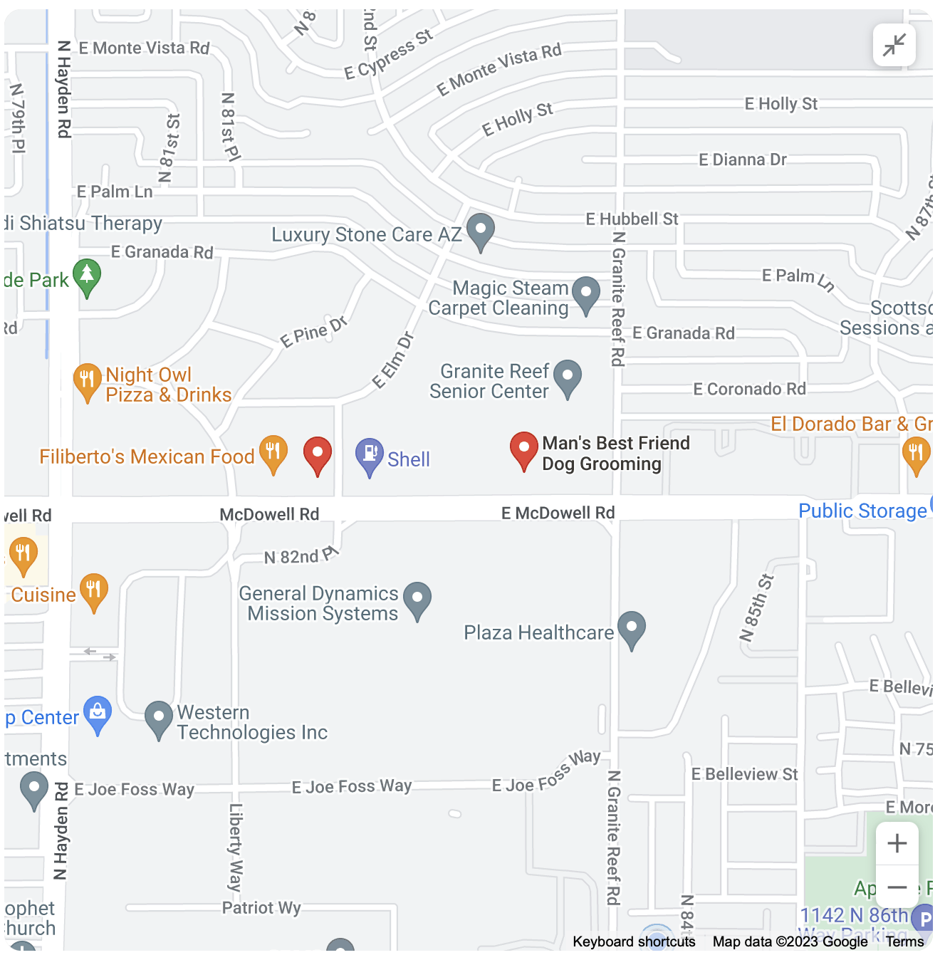
Contact
A Dog’s Life
Home
Services
How to
Contact
A Dog’s Life
Home
Services
How to
Contact
Have a question?
Have a question?
Contact us here at:
Phone: (480)867-5309
Email: Prakesh@scc.edu
Contact us here at
Phone: (480)867-5309
Email: Prakesh@scc.edu

